Slide 1


Padlet Link:
Password:
PHY2004

Slide 2

PHY2004: Electromagnetism and Optics
Lecture 11:
Electric circuits:
basics
Dr. Charlotte Palmer/Prof. Gianluca Sarri

Slide 3
The simplest electric circuit
I
U U=RI
Note:
If you cross a resistor in the same direction as the current, the change in potential is – IR (there is a potential drop).
In a circuit a battery is used to create a voltage between the positive and negative terminals. We have an electrostatic potential which is single valued at each point in space so we know that the overall potential difference around a closed loop must be zero because we end up back at the same point – same potential.
This effectively is, in circuitry, the Kirchoff’s loop rule:
The sum of the voltages around a closed circuit is zero
Typically we assume no voltage drop over the wires, so the potential is dissipated in circuit components like resistors.
Dr. Charlotte Palmer/Prof. Gianluca Sarri

Slide 4
Resistance
In its simplest form, resistance consists of the “hindrance” a current experiences when propagating through a conductor. It mostly relates to the energy loss experienced by electrons scattered by the nuclei of the material
Resistance depends on the material properties, including size and temperatures (e.g. long thin wires have higher resistance).
ΔV
Resistance of dielectrics (like air) is very large (infinite)
For conductors we can use Ohm’s law to relate the voltage, current and resistance.
Dr. Charlotte Palmer/Prof. Gianluca Sarri

Slide 5
Conductivity and resistivity
Unlike resistance, resistivity is an intrinsic property of a material and does not depend on the specific shape of the conductor used.
A
Resistivity uses the symbol, 𝜌, and can be used to determine resistance. For a wire:
We can combine familiar expressions to relate resistivity to electric field, E, and current density, J
L
Conductivity:
Perfect insulators (air, vacuum):
Insulators (silicon, salt water):
Conductors (metals):
J
Take care to make sure ρ is not confused with charge density when you’re using it.
Resistivity ρ
The inverse of the resistivity is the conductivity:
Generalised Ohm’s law
Dr. Charlotte Palmer/Prof. Gianluca Sarri

Slide 6
The (nearly) simplest electric circuit
I I₁
U
I₂
Charge has to be conserved around a circuit, so if currents encounter
a bifurcation, the overall amount of current entering the split must be equal to the overall amount of current leaving it.
This effectively is, in circuitry, the Kirchoff’s junction rule:
The current flowing into and out from a node must be equal
Dr. Charlotte Palmer/Prof. Gianluca Sarri

Slide 7
Sum of resistances in series
We can use Kirchoff’s voltage law to describe how to add resistors in series:
U₁=R₁I
I
U U₂=R₂I
Resistors in series add linearly:
Dr. Charlotte Palmer/Prof. Gianluca Sarri

Slide 8
Sum of resistances in parallel
I_{total}
U U₁=R₁I₁
U₂ = I₂R₂
Resistors in parallel add in inverse:
Dr. Charlotte Palmer/Prof. Gianluca Sarri

Slide 9
Sum of resistances in parallel
When we have more complicated circuits it can be useful to calculate equivalent resistance of different sections of the circuit.
U₁ = I_{total}R₁
I_{total}
U U₃=R₃I₃
U₂ = I₂R₂
Total resistance is then:
Resistors dissipate electrical power as heat, with the dissipated power across an element given by:
Dr. Charlotte Palmer/Prof. Gianluca Sarri

Slide 10
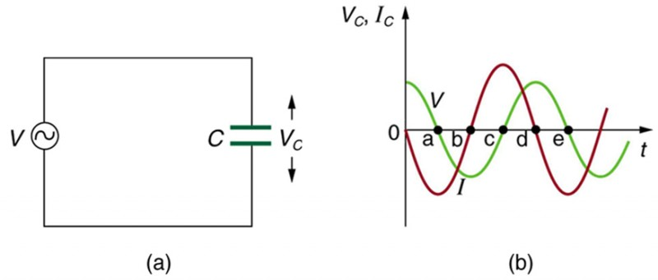
Time-varying circuits
In simple DC circuits we have constant source voltage with constant direction.
In AC circuits we have a source voltage that is varying with time, and this leads to a changing current with time and the generation of changing electric and magnetic fields.
In both of these types of circuits resistors behave with the voltage and current varying linearly with one another as V = IR
More complicated circuits contain components that do vary with time like capacitors and inductors. These influence the relative phase of the voltage and current.
When considering these circuits, opposition to the flow of current can be complex and we refer to it with different names.
From Lumen Learning
Dr. Charlotte Palmer/Prof. Gianluca Sarri

Slide 11
Opposition to current flow (Ohms)
Impedance, Z – includes all forms of opposition to current flow
Combination of resistance and reactance – leads to 0-90 degree phase change between current and voltage.
Is combined in the same way as resistors in series and parallel.
For resistors – equal to the resistance
For capacitors/inductors – infinite/zero for a DC circuit, complex for an AC circuit.
Resistance, R– friction against the current flow
Causes a voltage drop that is in-phase with the alternating current.
For resistors – this is the whole opposition to current flow
For capacitors/inductors – this is the real part of the impedance (dissipates energy)
Reactance, X – inertia against current flow
Found where electric of magnetic fields are generated by a voltage or current.
If we have pure reactance, the voltage drop is 90 degrees out of phase with the current
For capacitors – the voltage drop lags the current (phase angle -90 degrees)
For inductors – the voltage drop leads the current (phase angle + 90 degrees)
Dr. Charlotte Palmer/Prof. Gianluca Sarri

Slide 12
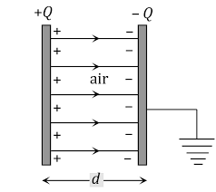
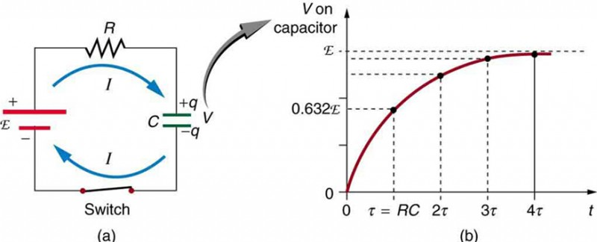
Capacitors
You have already encountered capacitors, as elements able to store charge, Q, and once a potential difference, V, is applied to them linked via their capacitance.
In DC circuits, the capacitor acts as a break in the circuit – charging instantly to a voltage matching the supply voltage (when the voltage of the source is opposed no current flows).
It’s often a better representation of a real DC circuit to consider a resistor and capacitor in series (RC circuit).
From The Fact Factor - Capacitor
Current is initially maximum because the back-voltage of the capacitor is zero.
Charging slows as the voltage across capacitor increases and current decreases.
From Lumen Learning – DC circuits containing resistors and capacitors
Dr. Charlotte Palmer/Prof. Gianluca Sarri

Slide 13
Capacitors
In AC circuits, current can flow across the capacitor:
When the voltage across the capacitor is maximum, the current is zero.
When the voltage across the source reduces to zero before switching direction, the voltage on the capacitor can drive current back towards the source so we have negative current and a decrease in voltage across the capacitor.
The voltage on the source drives current towards the other capacitor plate and current gradually reduces as the capacitor becomes fully charged.
Note: In AC circuits, capacitors cause a voltage lag behind the current of 90 degrees as energy is stored in the electric field between the plates, and then returned to the circuit with a delay.
Dr. Charlotte Palmer/Prof. Gianluca Sarri

Slide 14
Capacitive reactance
Current flows while the capacitor is charging and this causes an increase in potential difference across the capacitor until the source can’t overcome the hill anymore and current becomes zero.
From Lumen Learning – Reactance, Inductive and Capacitive
Capacitive reactance is the term used to describe the opposition to current flow:
Dr. Charlotte Palmer/Prof. Gianluca Sarri

Slide 15
Energy stored in a capacitor
The reactance and phase shift is caused by energy being converted into stored electric energy in the electric field between the plates and then back into the moving charges.
To determine how much energy is stored in the capacitor field we consider the work involved in moving test charges through the potential.
Generally we can calculate work as:
To charge a capacitor we start with zero potential and gradually increase so each increment of charge takes a little more work.
Remember:
We can express the changing voltage using the capacitance which fixes the relationship between charge and voltage.
Dr. Charlotte Palmer/Prof. Gianluca Sarri

Slide 16
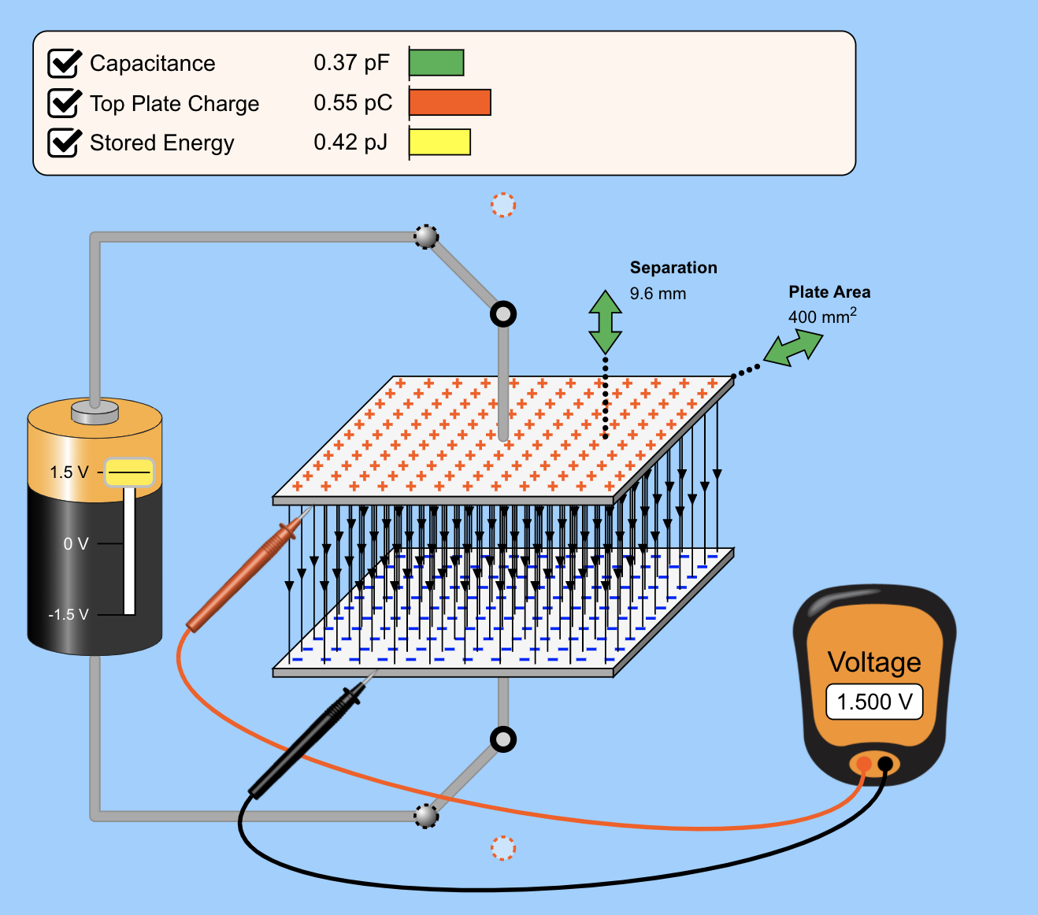
Capacitors
To build an intuition about capacitors and how capacitance, electric field and stored energy vary depending on the capacitor plate size, separation and voltage of the source have a play with the simulator (left).
From Colorado: https://phet.colorado.edu/sims/html/capacitor-lab-basics/latest/capacitor-lab-basics_en.html
Dr. Charlotte Palmer/Prof. Gianluca Sarri

Slide 17
Combining Capacitors
We can combine capacitors arranged in series and parallel using the following rules.
Capacitors in series
Capacitors in parallel
Kirchoff’s junction rule
Kirchoff’s voltage loop
Kirchoff’s voltage loop
Kirchoff’s junction rule
Dr. Charlotte Palmer/Prof. Gianluca Sarri

Slide 18
Inductance
Currents can induce a magnetic field and changing currents induce changing magnetic fields which provide induced currents that oppose the change (Lenz’s law)!
Inductors are used to prevent sudden changes in circuits. When things are steady, they behave like regular wires.
Choose Amperian loop where field is negligible or perpendicular except inside the solenoid.
The amount of magnetic flux going through our loops is:
Inductance, L, of a solenoid
Dr. Charlotte Palmer/Prof. Gianluca Sarri

Slide 19
Inductance
Currents can induce a magnetic field and changing currents induce changing magnetic fields which provide induced currents that oppose the change (Lenz’s law)!
Inductors are used to prevent sudden changes in circuits. When things are steady, they behave like regular wires.
Choose Amperian loop where field is negligible or perpendicular except inside the solenoid.
Note: inductance is more generally defined as the ratio of the induced voltage (emf) to the rate of change of current driving the emf.
This is our voltage drop across the inductor.
The amount of magnetic flux going through our loops is:
Inductance, L, of a solenoid
Dr. Charlotte Palmer/Prof. Gianluca Sarri

Slide 20
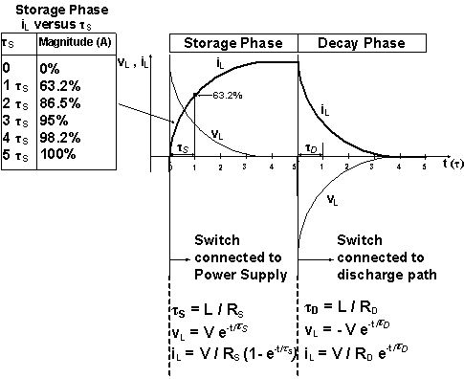
Inductance
When we have an inductor in a DC circuit it will initially oppose the flow of current once the circuit is closed.
If the circuit is broken (a switch is opened), the inductor will provide gradually decreasing emf to maintain current until the magnetic field is depleted.
In an AC circuit, the inductor will lead current to lag behind the voltage by 90 degrees.
The opposition to flow of current is given by the impedance of the inductor.
Like a capacitor, an ideal inductor has no resistance and the impedance is due purely to inductive reactance.
From CMM.gov: Inductor in DC circuit
Dr. Charlotte Palmer/Prof. Gianluca Sarri

Slide 21
Energy storage in magnetic fields
Like the capacitor we have energy stored in the magnetic field of the inductor.
Start by considering work done on a unit of charge as it passes the inductor.
Note: Work is being done against the emf.
If energy is being store in the inductor, there will be a voltage drop across the inductor as potential is turned into magnetic field.
If energy is being drained from the inductor, then the energy is being supplied to the circuit so the potential difference increases.
Remember:
Good discussion on Wikipedia: Inductor and Libretexts: Magnetic field energy
Dr. Charlotte Palmer/Prof. Gianluca Sarri

Slide 22
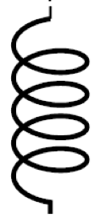
Combining inductors
The inductance of inductors in series add in the same way as the capacitance for series capacitors or the resistance for series resistors. This can be determined by again considering Kirchoff’s laws.
Charging inductors in series
Charging inductors in parallel
L₁
L₁
L₂
L₂
Equivalent inductance
Equivalent inductance
Note: These rules are only true if there is no mutual inductance between the inductors (the magnetic field on one inductor doesn’t then interact with another inductor).
Dr. Charlotte Palmer/Prof. Gianluca Sarri

Slide 23
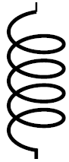
Main passive components of a circuit
U₁=RI
I
U
Resistors
Voltage source
Inductors
Capacitors
Note: Current is the rate of change of charge with time so charge is the integral of current with time.
Dr. Charlotte Palmer/Prof. Gianluca Sarri

Slide 24
Determining impedance and phase
The impedance of a system or element can be determined by combining the resistance and reactance as:
Here, the total reactance is given as:
The phase lag between the voltage and current depends on the relative magnitudes of resistance and current and can be found using:
Impedance
Complex reactance
Real resistance
Dr. Charlotte Palmer/Prof. Gianluca Sarri

Slide 25
Main passive components of a circuit
Energy stored/dissipated:
Resistor: E = VIt
Capacitor: E = CU²/2
Inductance: E= LI²/2
Let us assume we have a current that is sinusoidal in time:
Voltage-current relation
Impedance
Resistor: V = RI Z = R
Capacitor: V = -jI/ωC Z = -j/ωC
Inductance: V= jωL I Z = jωL
Dr. Charlotte Palmer/Prof. Gianluca Sarri

Slide 26
Main passive components of a circuit
Electrical Element | Instantaneous u/i relation | Complex Impedance, Z | Energy stored
Resistor
Capacitance
Inductance
Note: i can often be used in place of j to represent and
Dr. Charlotte Palmer/Prof. Gianluca Sarri

